Slide 1
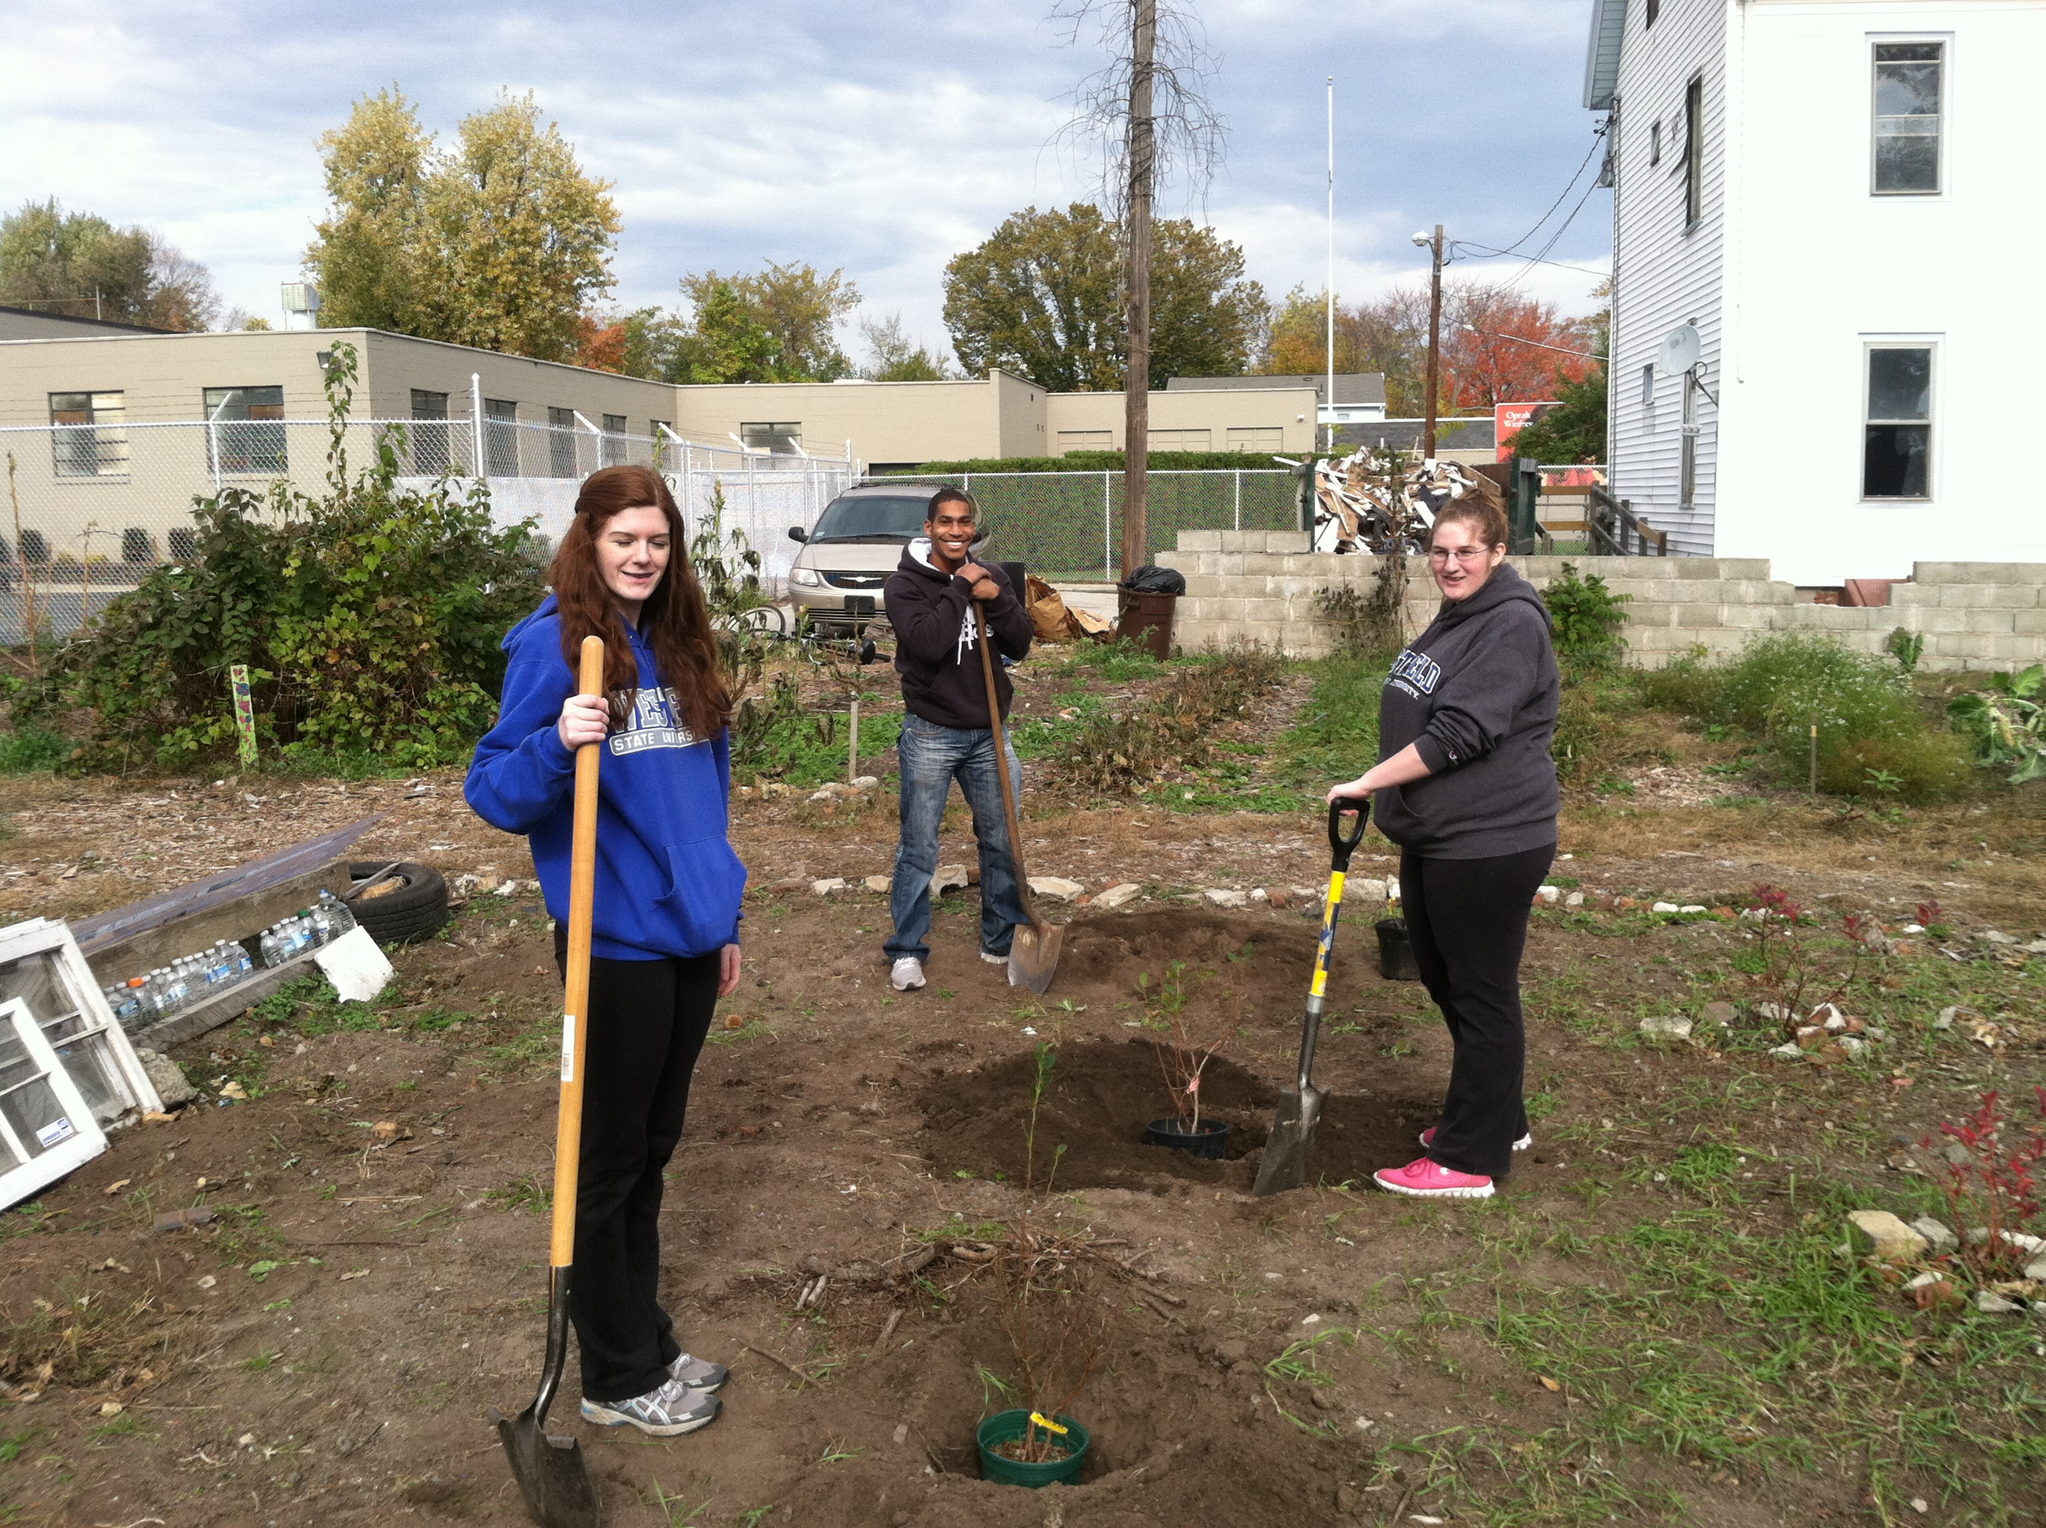
Cultivating Engaged Citizens: Thoughts on Best Practices, Challenges and Opportunities in Civic Learning and Democratic Engagement at

Slide 2
Road Map
Something New Under the Sun?
Implementation
Whither Civic Learning and Democratic Engagement?

Slide 3
Something New Under the Sun?
Westfield State University gets a Civic Engagement initiative!
Supporting and expanding rather than usurping existing practices
Defining terms and institutional identity
Getting from here to there
Recruiting a director and establishing an Advisory committee
Assembling an academic program
Establishing an office of Civic Learning and Democratic Engagement
VISTAs, partnerships and national programs

Slide 4
Implementation
Incentivizing course development
Supporting and encouraging student travel and service-learning abroad
Expanding public school partnerships with MACC Americorps VISTA support
Supporting curriculum expansion and faculty buy-in through professional development opportunities

Slide 5
Whither Civic Learning and Democratic Engagement?
Faculty buy-in and support are crucial
The spectrum of Civic Learning and Democratic Engagement practices should be examined in the context of the University’s mission
Full-time, dedicated staff are required for campus-wide successes to be sustained
Partnerships will emerge organically and be rooted in communities and networks

Slide 6
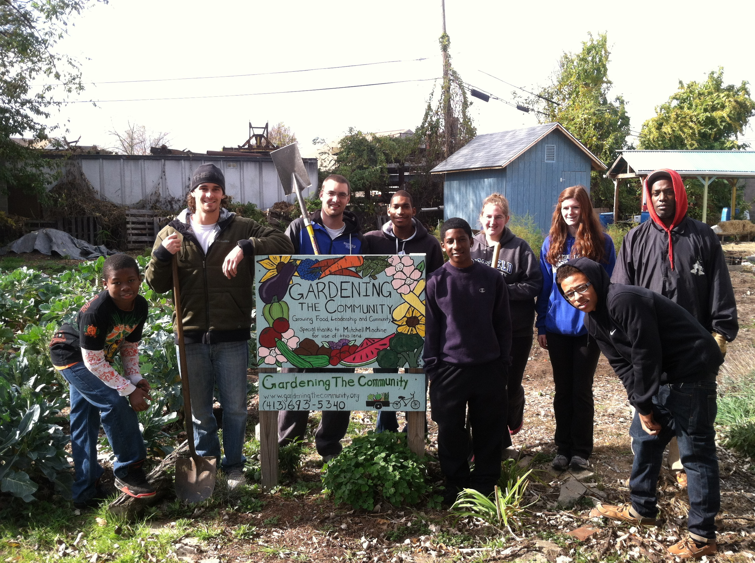

Slide 7
Questions?

